Slide 1


MIDDLE School RANKING PREDICTIVE ANALYSIS DATA SCIENCE PROJECT

Slide 2


CONTENTS
BUSINESS CASE
DATA ACQUISITION
DATA PREPERATION
DATA VISUALIZATION
EXPLORATORY DATA ANALYSIS
HYPOTHESIS MODELING
EVALUATION
CONCLUSION
OPERATIONALIZATION

Slide 3
BUSINESS CASE
School Rank Analyzer provides ranking for middle schools in all 50 states
Objective of this study is to provide a predictive model to establish ranking based on available parameters

Slide 4
DATA ACQUISITION
Current dataset is for Middle School
Data was obtained from data server in csv format

Slide 5
DATA PREPARATION
There are a total of 1998 records
No Duplicate values found in the dataset.
Number Fulltime Teachers missing for 23 schools (11 of which are also missing Rank 2105-16)
Percent of Students by Race data is missing for 4 schools
Average Standard Score 2015-16 and Rank 2105-16 is missing for 46 schools
In total, 62 (3.1%) records were ignored for this analysis.
After cleaning the records, 96.9% of original data is retained for data analysis.

Slide 6
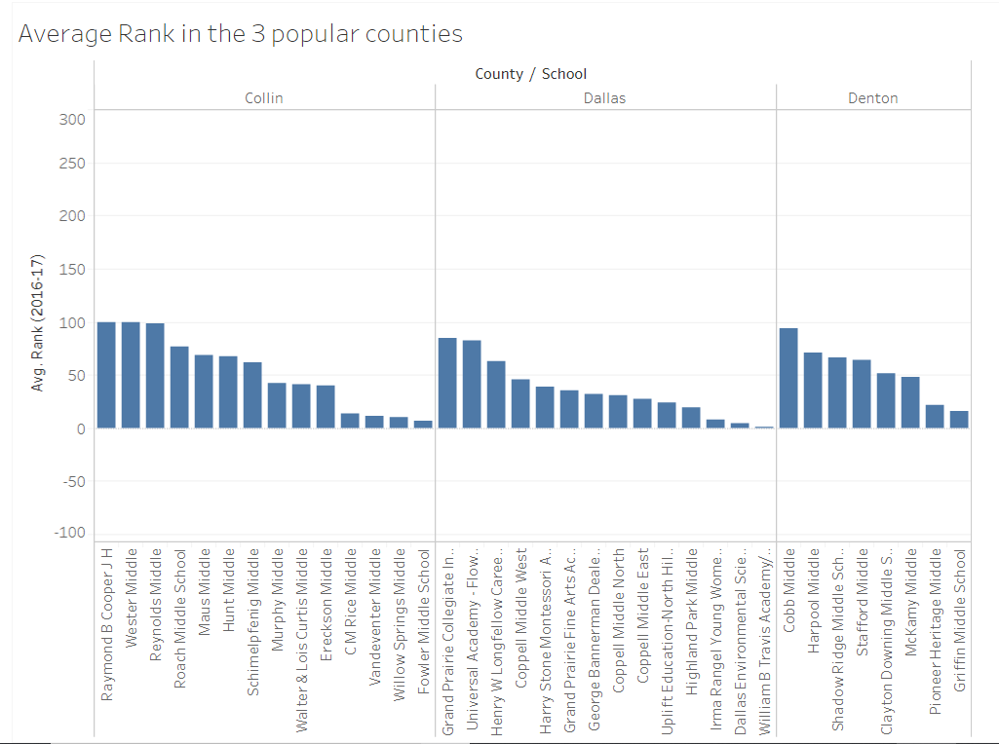
DATA VISUALIZATION
Average rank in 3 popular counties

Slide 7
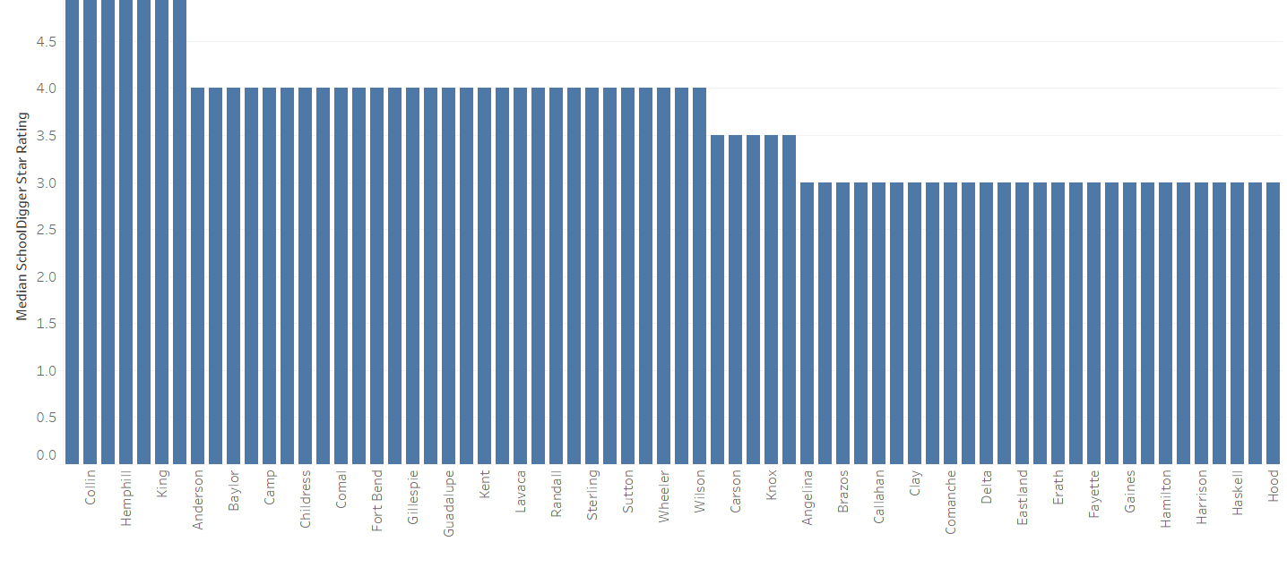
Data visualization
Median school digger by county

Slide 8
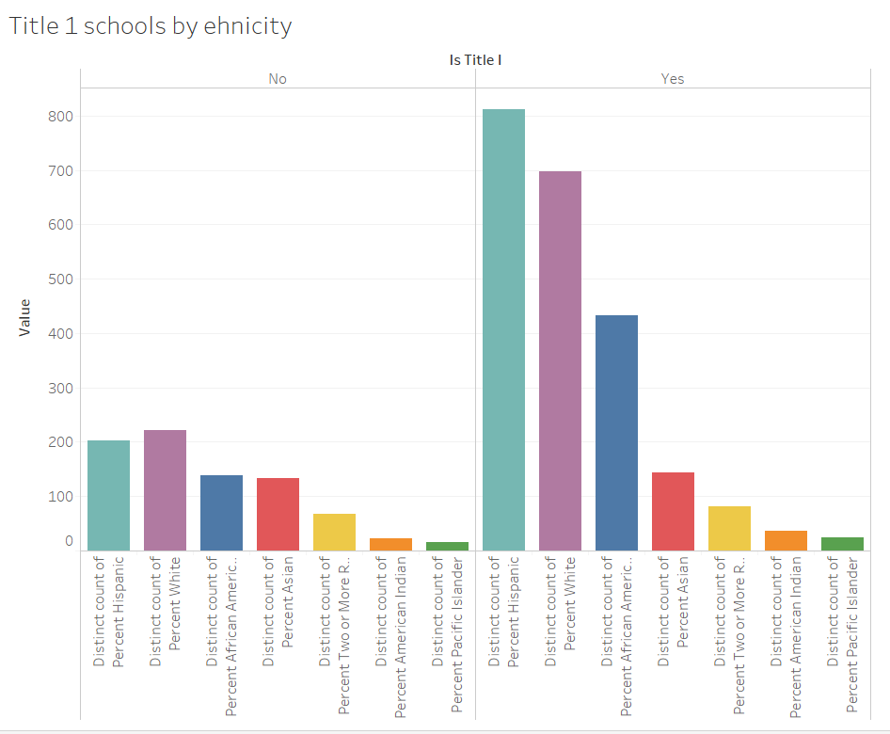
Data visualization
HISPANIC ETHNICITY IS THE MOST DOMINANT GROUP FOR TITLE 1 SCHOOL

Slide 9


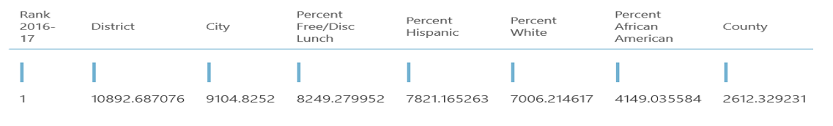
Exploratory data analysis
TOP 5 INFLUENCERS*
District
City
Percent Free/Disc Lunch
Percent Hispanic
Percent White
* Based on Chi Squared Test with Feature Selection module in Azure Machine Learning Studio

